Slide 1
Composite Components
What is it?
Encapsulated piece of functionality
Why use it?
Decreases size of files
Ready to distribute
Ready for re-use

Slide 2
Structure
HTML file (view)
JavaScript file (viewModel)
Loader file (starting point)
JSON configuration file (parameters)
CSS file (styling)
Plaatje structuur CC

Slide 3
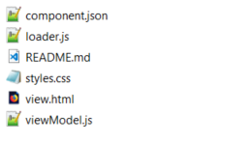
Creating your component
ojet create component <component-name>
ojet create component first-component

Slide 4
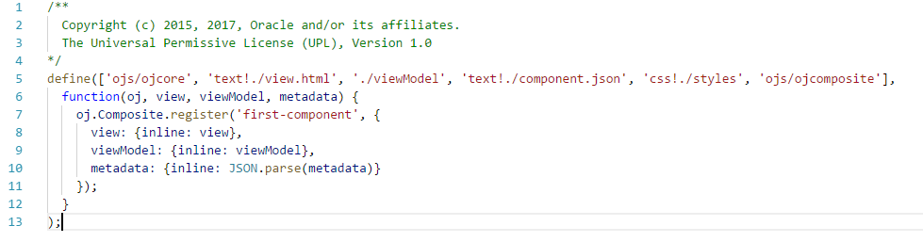
Loader.js

Slide 5
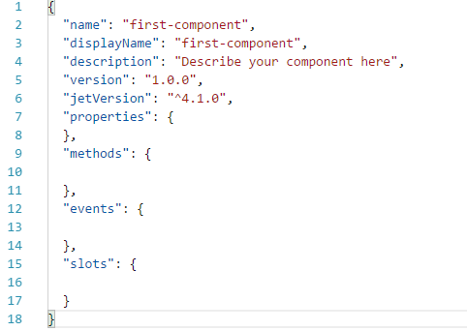
Component.json

Slide 6
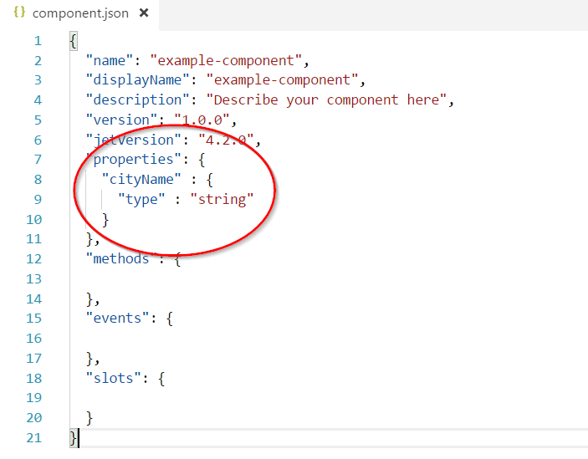
Example

Slide 7
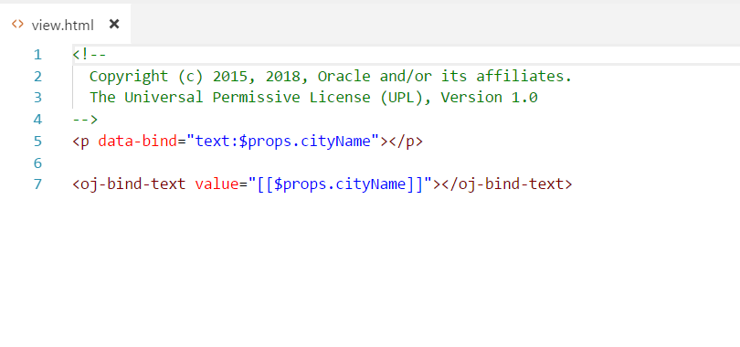
Example

Slide 8
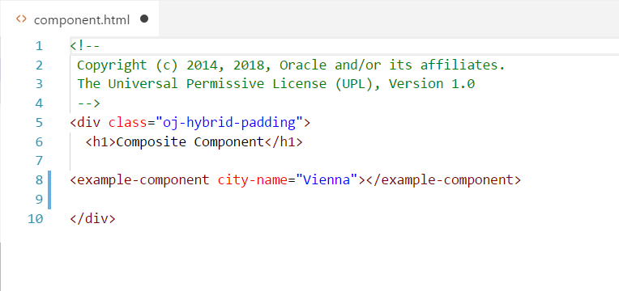
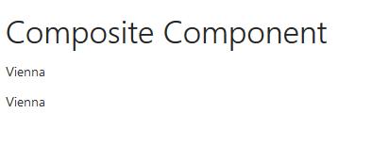
Example
Camel-case property names are converted into case-insensitive HTML element attributes with hyphens at the camel-case break point of the original name.

Slide 9
Excercise notes
Simple component for use in VBCS training
Expand on this with extra excercises

